Slide 1

Australia Award
- Africa
Maroof Adebayo Alatise

Slide 2

1. Why study in Australia?
The country & opportunities.
Education system
2. Overview of Australia Award -Africa
Purpose
Benefits
CONTENTS
3. Application, submission & selection process
Eligibility criteria
Supporting documents
4. Tips on how to excel in the interview and
win the scholarship
5. Q & A
personal advice

Slide 3

Add title
Why Australia?
One of the world largest economy (ranked 11th global largest economy)
Very peaceful country with outstanding health system
One of the countries with the best education system, now one of the largest destinations for international students
There are seven universities among the best 100 in The Times World University Ranking, 2023.

Slide 4
Overview of the Australia Award

Slide 5
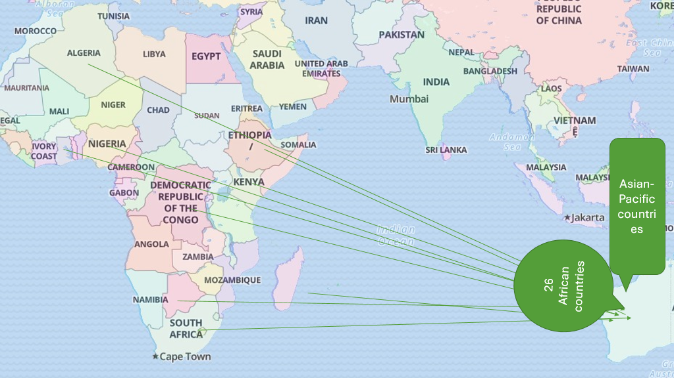
Overview of the Australia Award

Slide 6

Add title
To contribute to socio-economic development outcomes of African nations and the Sustainable Development Goals.
How?:
Strengthening leadership and skills
Focus: Agriculture and food security, climate change and adaptation, renewable energy, mining governance and countering terrorism and violent extremism
To foster security, stability and prosperity of the African continent

Slide 7
Benefits
Promote skills acquisition and transfer
Enhance cultural diversity and Promote cultural exchange
Australia
Improves bilateral/multilateral relationships
Maintain Australia workforce and foster its economic buoyancy

Slide 8







Benefits
Awardee
Offers a life-changing experience, life-long connections
Opportunity for world class education
Improved knowledge, skill and expertise
Promote overall marketability
Opportunity to work
Opportunity to work and live in Australia (after 2 yrs)

Slide 9






Entitlement/Benefit
Air travel to and from Australia
Establishment Allowance
Introductory Academic Program
Full Tuition fee

Slide 10





Entitlement/Benefit
Contribution to living expenses (CLE)
Overseas Student Health Cover (OSHC)
Supplementary Academic Support
Fieldwork Allowance

Slide 11


Application, submission & selection process

Slide 12
The Process
0
1
2
3
Complete Application and submit before deadline
Check your eligibility.
Save as you go.
Prepare and upload supporting documents
Create your account

Slide 13

Application process
Register/create Account on OASIS
Visit: Online Australia Scholarships Information System (OASIS) by 11.59PM AEST on 29 April 2023. (1:59 PM WAT).
Note: AEST is 10hrs ahead of WAT Zone

Slide 14
Eligibility?
01
Md to senior level professional applicants from the public service
Employees from private organizations
Employees from Non-Governmental Organizations,
Actors in the community-based sectors/civil society organizations
Must have completed your undergrad. studies
02
03
04
05
WHO?

Slide 15
Eligible Countries
S/N | Countries | S/N | Countries
1 | Algeria | 14 | Mozambique
2 | Botswana | 15 | Namibia
3 | Congo | 16 | Nigeria
4 | Egypt | 17 | Rwanda
5 | Ethiopia | 18 | Senegal
6 | Gabon | 19 | Sierra Leone
7 | Ghana | 20 | South Africa
8 | Kenya | 21 | Sudan
9 | Liberia | 22 | Tanzania
10 | Madagascar | 23 | The Gambia
11 | Malawi | 24 | Uganda
12 | Mauritius | 25 | Zambia
13 | Morocco | 26 | Zimbabwe
34%
Add your words here,according to your need to draw the text box size

Slide 16

Supporting Documents
6
4
2
Detailed Resume
Birth certificate/ age Declaration
Academic transcript
3
1
NYSC Certificate/ Exemption letter
5
Undergraduate certificate
Evidence of Employment

Slide 17
Other Supporting Documents
9
Others
8
Publications
Evidence of volunteering/ Humanitarian services
Certificate/awards of excellence
etc
Passport-Biodata page
7
IELTS Result

Slide 18

Manage your choices
You are to select two related courses and two universities of your choice.

Slide 19
Manage your choices
Top 37 universities in Australia 2023
Click each institution to view its full World University Rankings 2023 profile and browse their official website page.
Aus. Rank | World | University | City | State/territory
1 | 34 | University of Melbourne | Melbourne | Victoria
2 | 44 | Monash University | Melbourne | Victoria
3 | 53 | The University of Queensland | Brisbane | Queensland
4 | =54 | University of Sydney | Sydney | New South Wales
5 | 62 | Australian National University | Canberra | Australian Capital
6 | =71 | UNSW Sydney | Sydney | New South Wales
7 | 88 | University of Adelaide | Adelaide | South Australia
8 | =131 | The University of Western Australia | Perth | Western Australia
9 | 133 | University of Technology Sydney | Sydney | New South Wales

Slide 20
Aus. Rank | World | University | City | State/territory
10 | 175 | Macquarie University | Sydney | New South Wales
=11 | 201–250 | Curtin University | Perth | Western Australia
=11 | 201–250 | University of Newcastle | Callaghan | New South Wales
=11 | 201–250 | Queensland University of Technology | Brisbane | Queensland
=11 | 201–250 | Western Sydney University | Sydney | New South Wales
=11 | 201–250 | University of Wollongong | Wollongong | New South Wales
=16 | 251–300 | Australian Catholic University | Sydney | New South Wales
=16 | 251–300 | Bond University | Gold Coast | Queensland
=16 | 251–300 | University of Canberra | Canberra | Australian Capital
=16 | 251–300 | Deakin University | Geelong | Victoria
=16 | 251–300 | Griffith University | Brisbane, Gold Coast, Logan | Queensland
=16 | 251–300 | La Trobe University | Melbourne | Victoria
=22 | 301–350 | Flinders University | Adelaide | South Australia
=22 | 301–350 | RMIT University | Melbourne | Victoria

Slide 21
Aus. Rank | World | University | City | State/territory
=22 | 301–350 | University of South Australia | Adelaide | South Australia
=22 | 301–350 | University of Southern Queensland | Toowoomba | Queensland
=22 | 301–350 | Swinburne University of Technology | Hawthorn | Victoria
=22 | 301–350 | University of Tasmania | Hobart | Tasmania
=28 | 351–400 | Charles Darwin University | Casuarina | Northern Territory
=28 | 351–400 | Edith Cowan University | Joondalup | Western Australia
=28 | 351–400 | James Cook University | Townsville City | Queensland
31 | 401–500 | Murdoch University | Murdoch | Western Australia
32 | 501–600 | Victoria University | Melbourne | Victoria
=33 | 601–800 | Central Queensland University | Rockhampton | Queensland
=33 | 601–800 | Federation University Australia | Brisbane | Victoria
=33 | 601–800 | Southern Cross University | Lismore | New South Wales
=33 | 601–800 | University of the Sunshine Coast | Sunshine Coast | Queensland
37 | 1001–1200 | Charles Sturt University | Bathurst | New South Wales

Slide 22








Manage your choices
Note: It is advisable to select 1 out of the “Group of Eight”, & 1 from the remaining universities.
Group of Eight Members

Slide 23
Prepare: choose!
Priority Areas
Climate change
Agriculture and food security
1
2
3
4
Foreign policy and international security
Mining and energy

Slide 24
Prepare!!!
Personal statement and RAP
Reintegration
Action
Plan
(The Hallmark)
Write clearly and correctly! Link your points!!
Mind your grammar!!!
Demonstrate a deep understanding of your choice of courses, and reasons for your choice
What inform your choice of university?
Why Australia?
Why postgraduate education? What skills, knowledge and experience do you need and how will these contribute to your personal development, organization's goals? Give examples. Relate it to priority areas, development agenda and global targets (SDGs).
Talk about yourself. Avoid being boastful- academic credentials, personal attributes and achievements, leadership skills. Explain how you ensure social inclusion and inequity in your community/workplace. Give examples.

Slide 25
Prepare!!!
Employer’s statement
It must depict the expected skills and knowledge you need and how your new skills will further the attainment to goals and objectives, and national development (bearing in mind the priority areas).
It must contain your jobs description, its importance, and reflect your capacity, character and quest for knowledge and skills.
It must vouch for you, and ‘sell’ you but not boastfully! No hyperbole
CEO
Supervisor
Director
It is usually a two-page document that has two sections- (1) employer's expectations and plan and (2) employer’s commitment section.

Slide 26
SELECTION PROCESS
Academic competence
Potential outcome/contribution to your country development outcomes
SUCCESS
Employer’s statement; Your RAP
Professional and personal leadership attributes including relevant work experience.
Your CV; Your RAP

Slide 27
Personal Advice
How to excel in the interview
State/Describe the situation
Explain the Tasks
What Activities did you/your team engage in
And what was the Result(s)
Skills and Knowledge
Country’s Development priorities
Contribution to your current/future job
Development Agenda
Understanding the concept
How do you ensure this
Give examples
S-state
T- Task
A-Activity
R-Results
Master
Your
RAP
Equity/
Social inclusion
Sell yourself!
Development Agenda
Change
4
Devt
Give Examples
Use evidence
Use popular “Quotes”
Demonstrate knowledge, passion. Be confident!
Development Agenda
Understanding the context
Know your country’s plan till data
Why is your country at?
Relate this to SDG
How will you contribute
Give examples
Identify Challenges
Think about change
Demonstrate capacity for change
Demonstrate leadership trait in you!
Always Remember “STAR”

Slide 28

Lastly
Do not stop, please…!
Keep climbing!
Keep pushing!!
The top is in sight!!!
Thanks for Listening
https://streamyard.com/a894pcajdz

